Slide 1
Historic Preservation Review
3/17/2026

Slide 2
Applies to the Following Funding Programs:
Vermont Drinking Water State Revolving Loan Fund (DWSRF)
Vermont Water Infrastructure Improvement for the Nation Grants (WIIN Grants)
Vermont Clean Water State Revolving Loan Fund (CWSRF)
  WISPR & Stormwater
Vermont Pollution Control Grants (PC Grants)
Vermont Overflow Sewer Grants (OSG Grants)
Any state or federal funds administered through the municipal pollution control Project Priority List or Drinking Water Project Priority List
  ARPA CSO & VWWW

Slide 3
Agenda
New Staff - Chloe Hulsizer – Environmental Analyst – environmental reviews for CW and DW SRF programs (point of contact between consultants and SHPO)
New 2025 MOA
  New-ish Process (moved to Step 2)
  New Project Review Form
  New exemptions from SHPO consultation
The Section 106 Project Review Form found here:
  https://dec.vermont.gov/water-investment/water-financing/srf/environmental-review/SHPO or
  https://anrweb.vt.gov/DEC/IronPIG/DownloadFile.aspx?DID=216090&DVID=0

Slide 4
Reminder:
All resources for SHPO must be sent to your SRF/DCE contact:
Chloe.Hulsizer@Vermont.gov
ANR.DECSRFS106Consultation@vermont.gov
Your Assigned Design Engineer
Do not send your reports directly to VDHP
Notes:
- We will consolidate all of these resources and get them sent to SHPO. Archeological information can not be reviewed unless it is included in the Section 106 form

Slide 5
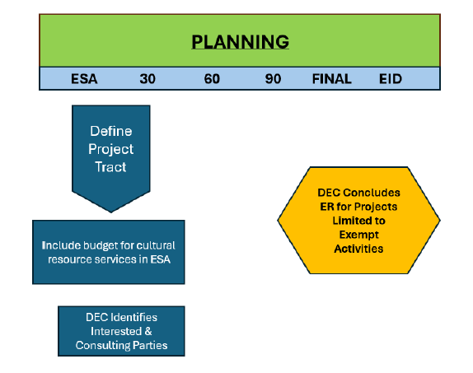
When your project is only exempt activities:
Step 1 (planning and preliminary engineering) page on DEC website - https://dec.vermont.gov/water-investment/water-financing/srf/step-1-state-revolving-fund-planning-and-preliminary
Note: PRF still required.
Notes:
We also have a new historic preservation process as part of the environmental review – this has been implemented for a few years
During the planning phase, the project tract is defined, and the historic preservation review is concluded using the Section 106 form for exempt activities

Slide 6
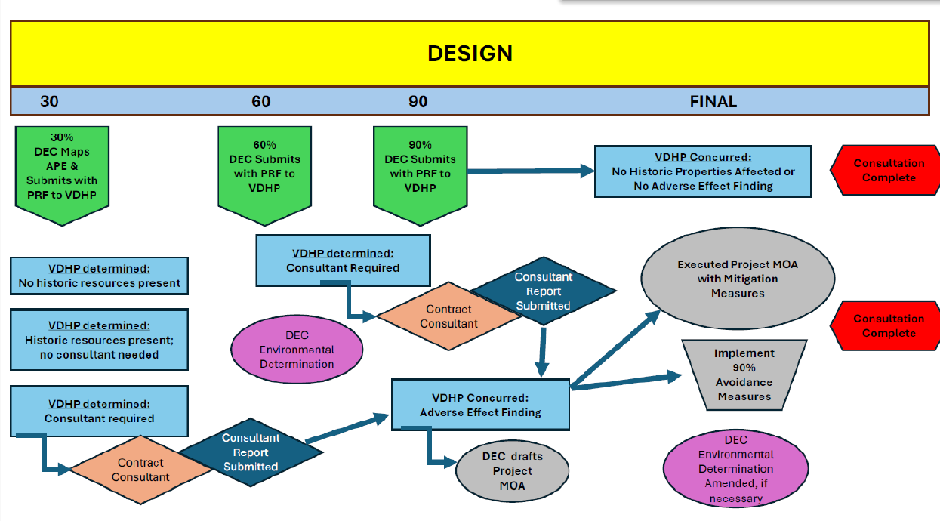
Step 2 (design) page on DEC website - https://dec.vermont.gov/water-investment/water-financing/srf/step-2-state-revolving-fund-final-design
Notes:
For all projects the consultant must send a Section 106 PRF to their DEC point of contact including any maps, 30% plans and the Area of Potential Effect
SHPO will use this to determine if any historic resources are present and if an archeological consultant will be required
During the 60 and 90 percent design phases, an updated Section 106 PRF must be submitted including the archaeological reports from the consultant
SHPO concurs finding of adverse effect

Slide 7
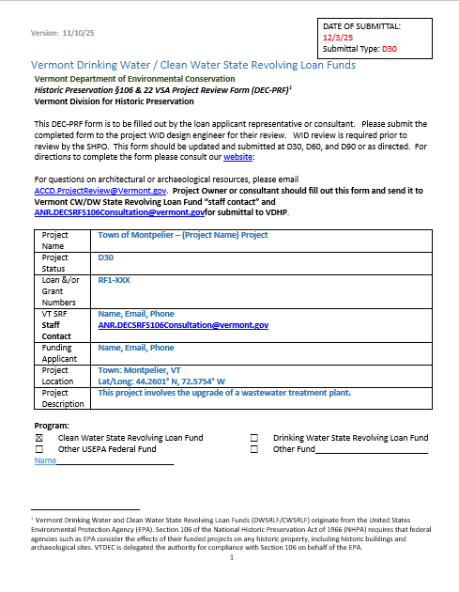
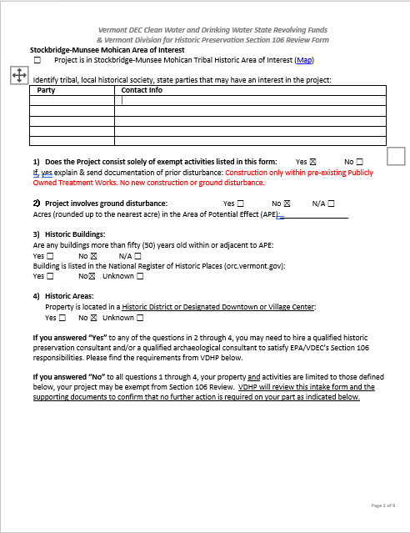
Notes:
Example of a Section 106 PRF for an exempt project
Questions 2-4 are answered no, and the exempt activity is described
Update heading for each submittal

Slide 8
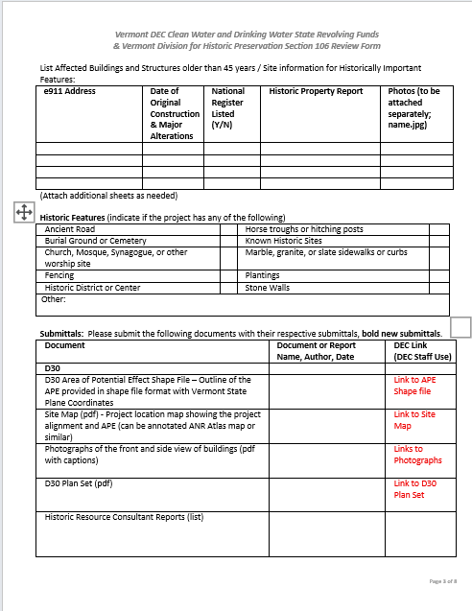
Notes:
PRF is still submitted for exempt project
Links are provided for D30 APE, site map, any photographs, and plans

Slide 9
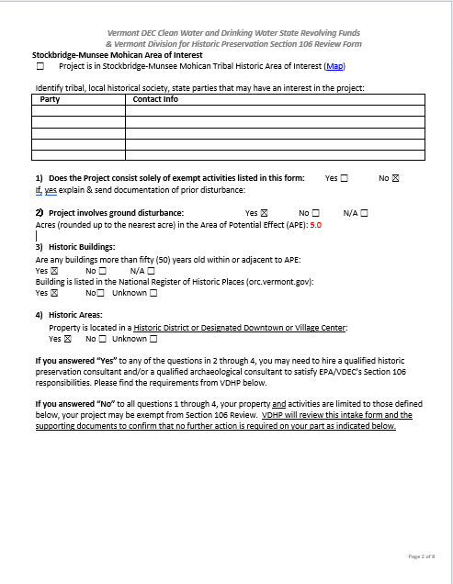
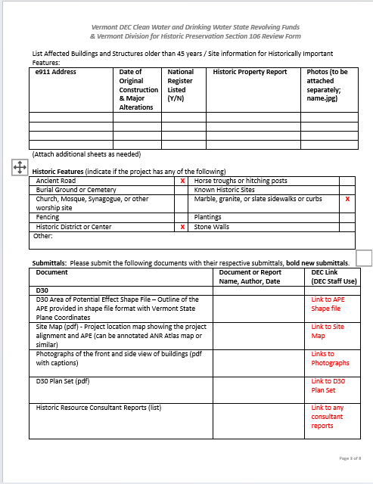
Notes:
Example of Section 106 PRF for non-exempt activity
Non-exempt if any of the questions 2 through 4 are answered yes
Links are once again provided for APE, site map, photographs, and plans
May be submitted during D30 to determine if archaeological consultant is necessary

Slide 10
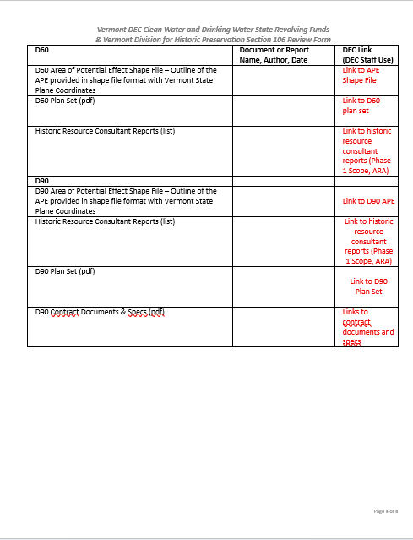
Notes:
- If archaeological consultant is required, resubmit Section 106 form during D60 and D90 phases with updated APE shape files, plan sets, D90 contract documents and specs, and all archaeological consultant reports (phase 1 scope, and ARA)

Slide 11
New Exemption #1 – WWTP Architecture
In August 2023, SHPO determined all existing Publicly Owned Treatment Works wastewater plants in Vermont to be non-historic and no further review under Section 106 is required if the scope of the project is limited to the buildings and structures. See list in Appendix H.
  New construction and ground disturbance within a previously undisturbed footprint are not exempt.
  Does not include pump stations, etc.
Notes:
- Projects not involving new construction or ground disturbance within an existing publicly owned treatment facility

Slide 12
New Exemption #2 - MHPs
Based on archaeological analysis completed as of May 1, 2025, the existing built footprints of mobile home parks are exempt from historic preservation review (aboveground and archaeological) by SHPO and VDHP. This exemption includes roadways and driveways, building pads, utilities, built infrastructure, graded yards, any other previously disturbed areas, and mobile homes. This exemption does not include manufactured housing developments, areas outside the existing built footprints of mobile home parks, and buildings over 50 years of age (except for mobile homes). Exempt mobile home parks as of May 1, 2025, are noted within the 2024 Mobile Home Park Registry.
Notes:
- Existing built footprints of mobile home parks are exempt from historic preservation review

Slide 13
New Exemption #3 –Plantings
Tree, shrub, and herbaceous plantings that involve:
  The emplacement of bare-root stock in shovel slits or root balls up to 24” diameter planted within slumped material along an eroded streambank or within plow zone soils;
    Definition of Plow Zone Soils: Plow Zone Soil is the top layer of soil that is disturbed by plowing.

Slide 14
New Exemption #4 – Lead Service Line (LSL) Rules
Included in the revised SHPO MOU – dated 3/16/2026
Lead Service Inventory related work required under the Safe Drinking Water Act and related rules is exempt:
  Inventory work involving excavation at the curb stop and within the public right-of-way limited to a 5-foot by 5-foot footprint or less
  Inventory work involving excavation outside the right-of-way if the Vactor Method is used
    Vactor Method: Vactor and water extraction of earth for one test pit, 30-inches in diameter or less per service line to be located at the curb stop.
  LSL replacement is not exempt.
  Exploratory excavation to locate service lines is not exempt.

Slide 15
Clarified Exemptions – De Minimus
Incidental Ground Disturbance - The development, construction, or renovation that involves the disturbance of an area less than 100 square feet to a depth diameter less than six (6) inches. Examples include drilled wells, springs, and water storage facilities.
  Presumes existing or non-vehicular access: any undeveloped vehicular access will need SHPO consultation.

Slide 16
Clarified Exemptions – WW Test Pits
Drilled Wells, Geotechnical Borings and other soil tests.
  In July 2025, SHPO determined the exploration for soil suitability determination for wastewater projects is an exempt activity. Backhoe test pits are not exempt, except for exploration for feasibility soil suitability determinations for wastewater projects.

Slide 17
Questions?
Thank you!

