Slide 1

Creating A Project Specific EJScreen Report v2.3
10/14/2024

Slide 2
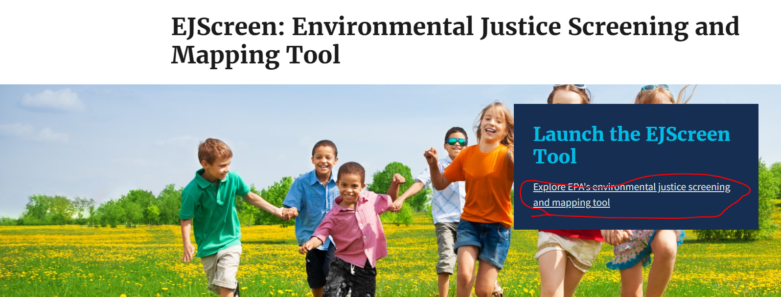
Go to EJScreen
https://www.epa.gov/ejscreen
Click to “Launch the EJScreen Tool”

Slide 3
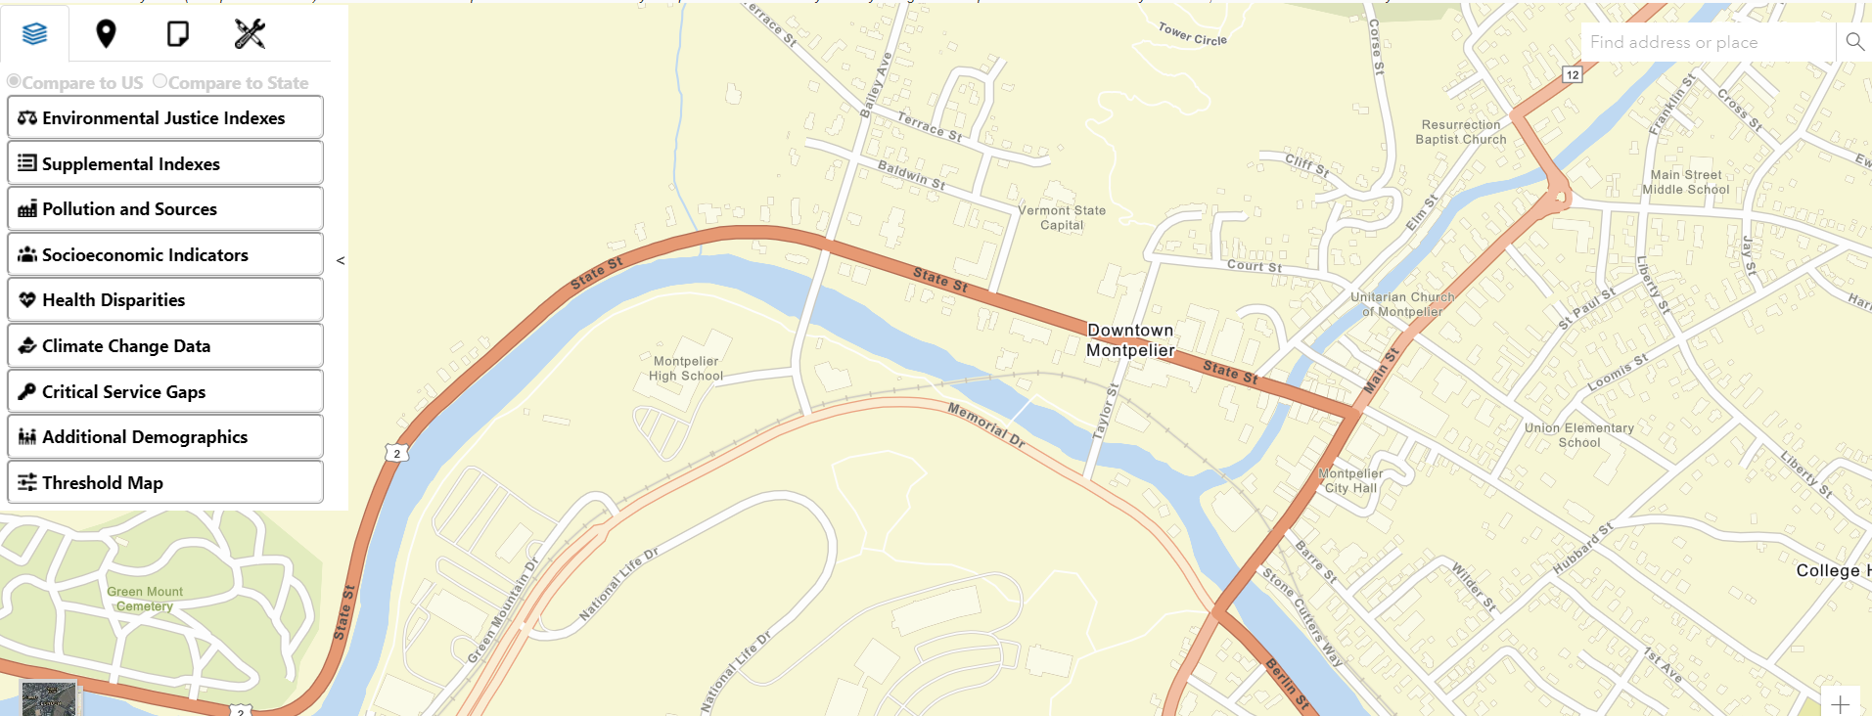
Navigate to the Project Area
By place, address, or by panning & zooming

Slide 4
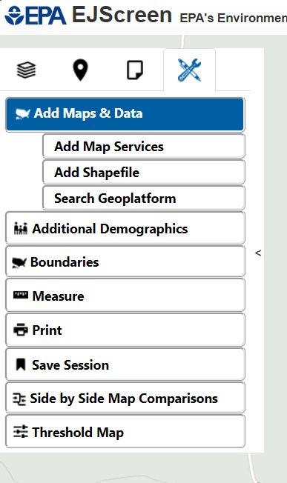
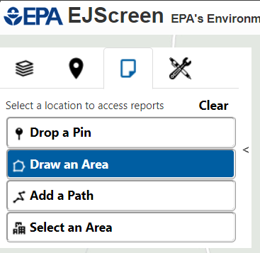


Add the Project Area to the Map
Can be by “Add Shapefile” – AutoCAD or Google Earth will let you export a polyline as a shapefile (zip), which can then be imported into the EJScreen tool.
Or can be sketched directly into the EJScreen Tool by clicking “Draw an Area”

Slide 5
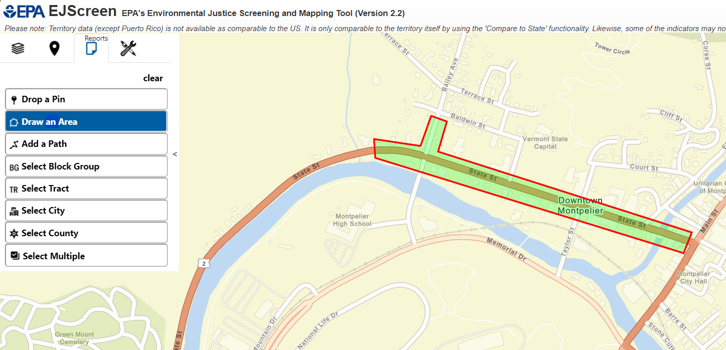
Upload your project area shapefile.

Slide 6
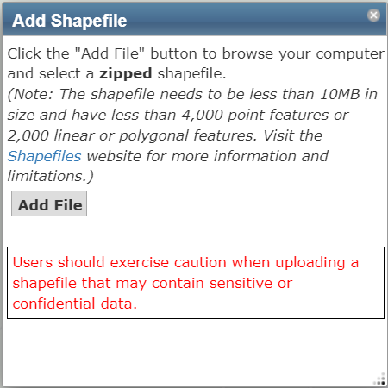
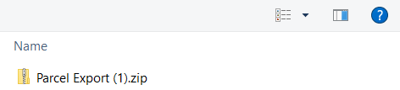



Upload your project area shapefile.
1
2
3

Slide 7
Draw your project area (closed polygon).

Slide 8
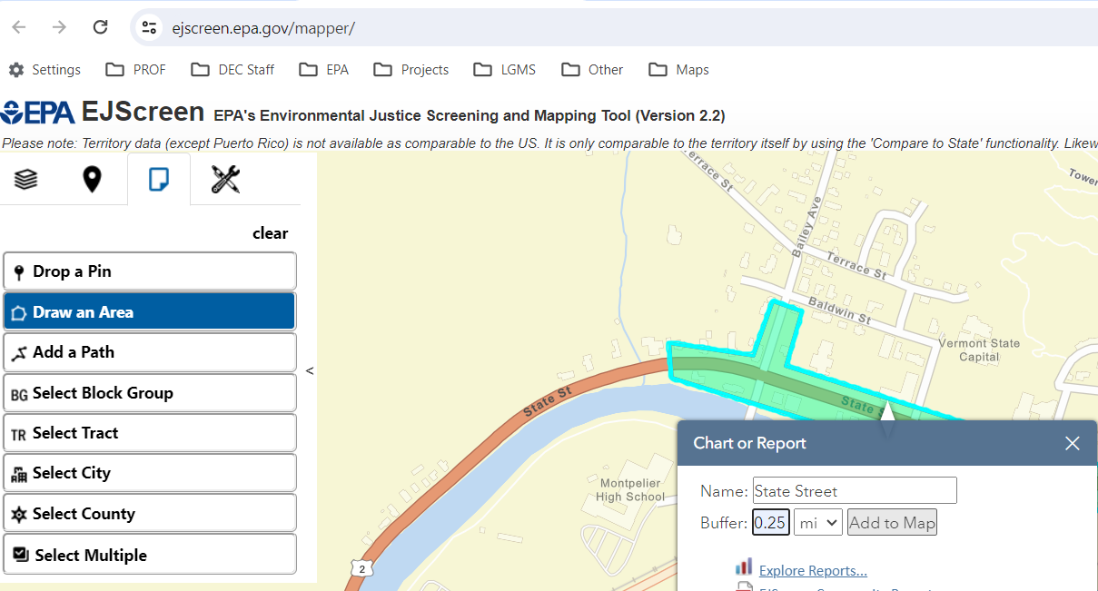
Create a Buffer Around the Project Area
Click on the project outline.
Dialogue Box Opens
Add a Name
Add a Buffer of 0.25 miles, or as discussed with the Environmental Reviewer
Click “Add to Map”

Slide 9
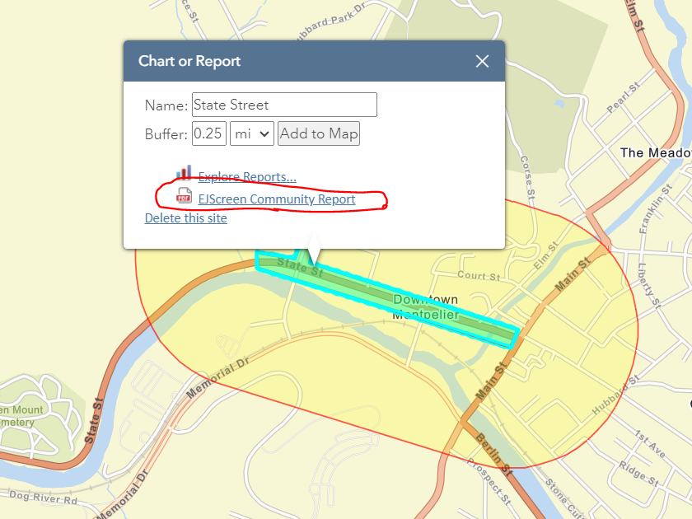
Generate EJScreen Community Report
Click EJScreen Community Report

Slide 10

Suggested Buffer Distances
Linear Projects 0.1-0.25 miles
Site Specific Projects 0.1-0.25 miles
Service Area Specific Projects – Service Area
Wells – Source Protection Area
Confer with your Design Engineer

Slide 11
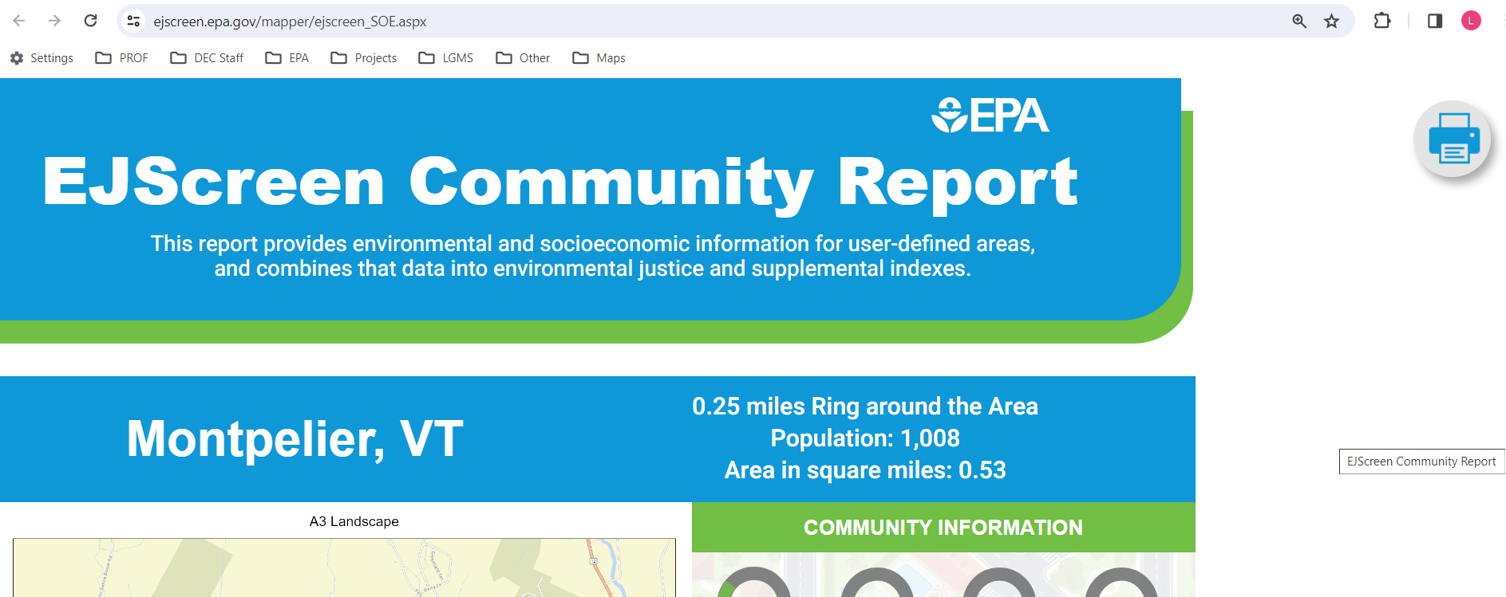

Print report to PDF

Slide 12
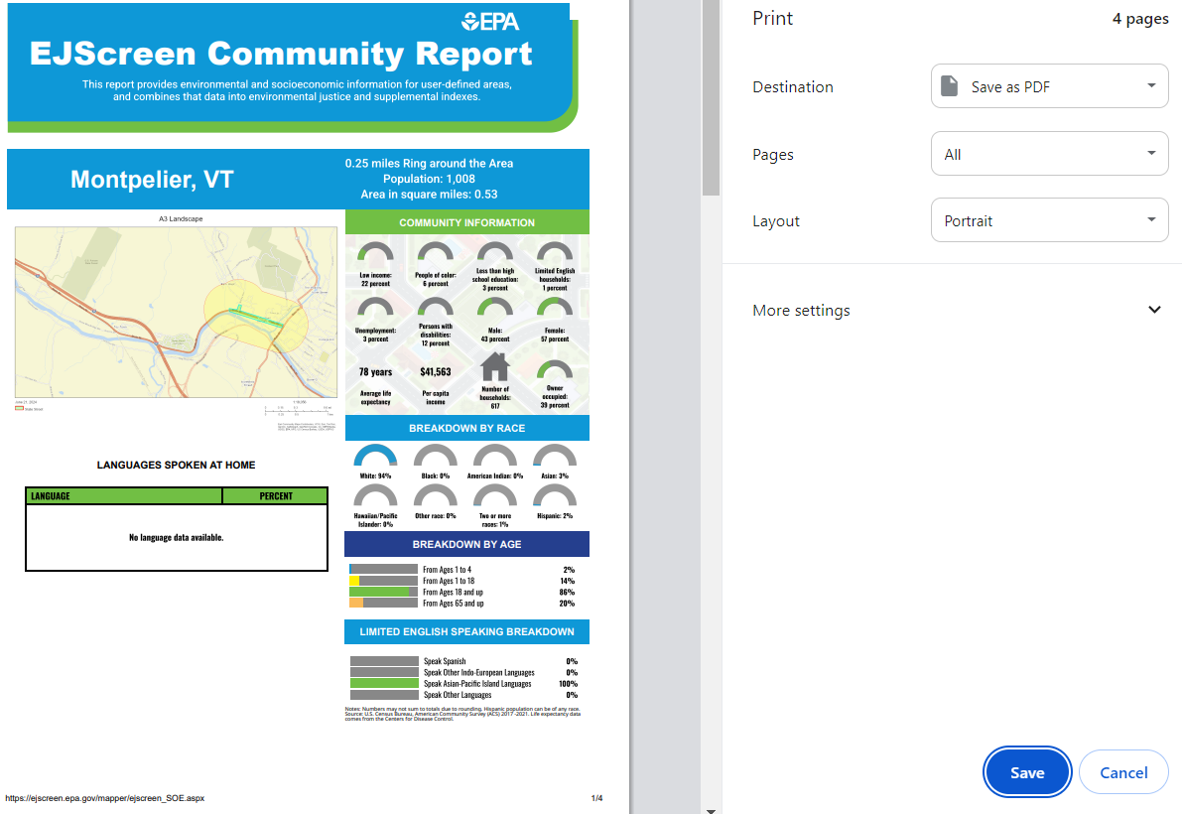
Save report & done.

Slide 13
For More See:
User Guide to the EJScreen Tool
Version 2.3 https://ejscreen.epa.gov/mapper/help/ejscreen_help.pdf

