Slide 1
BABA Waiver Update
4/18/24

Slide 2
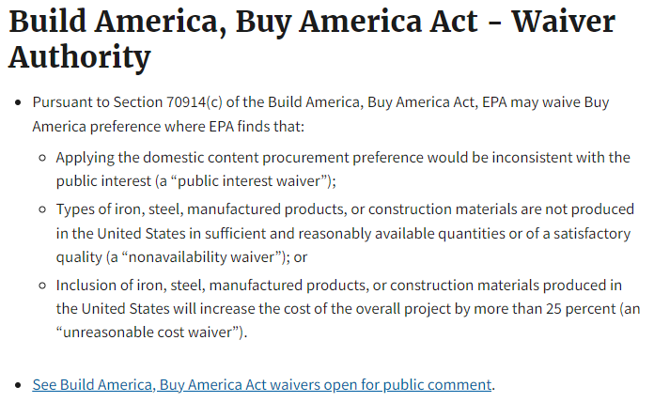

Slide 3
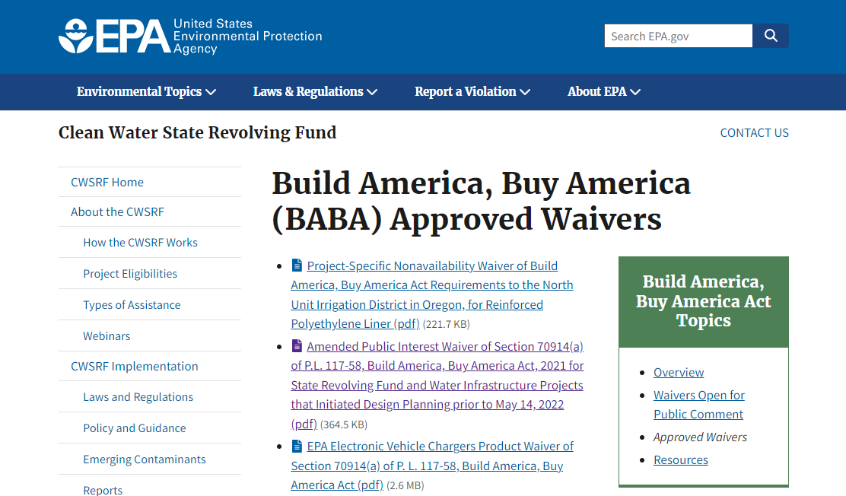
https://www.epa.gov/cwsrf/build-america-buy-america-baba-approved-waivers
Types of Waivers
Project Specific (Equipment specific)
Public Interest
  Adjustment Period
  Amended Adjustment Period
De Minimus
Small Project
Product Waivers
Minor Components (AIS)

Slide 4
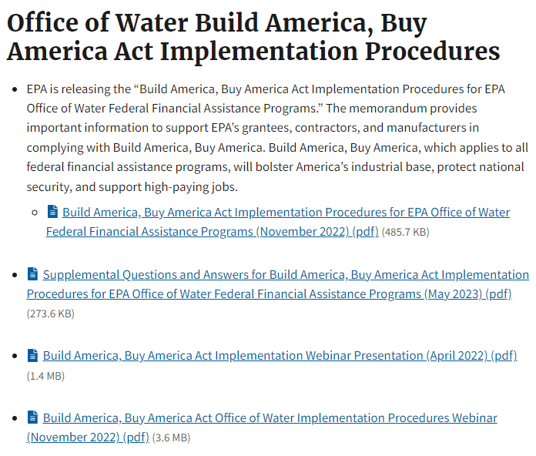
How to apply for a waiver…

Slide 5
Implementation Guidance
https://www.epa.gov/system/files/documents/2022-11/OW-BABA-Implementation-Procedures-Final-November-2022.pdf

Slide 6
Adjustment Period Waiver
Amended by Public Interest Waiver
(FFY 24 starts July 1, 2024)
Limits the applicability of the waiver to funding from federal capitalization grants for Federal Fiscal Years
"This waiver applies to funds expended after the effective date of the final waiver (November 13, 2023) for covered projects for which funding was appropriated in Federal Fiscal Year 2022 (FFY22) and 2023 (FFY23). For awards obligated on or after the effective date of the final waiver, the final waiver supersedes and replaces the earlier Adjustment Period Waiver for SRF projects issued by the EPA on September 2, 2022.“
Federal Fiscal Year 2022 or 2023 funds

Slide 7
Vermont Adjustment Period
Waiver Form
DCE is working on a new form, currently pending approval from WIFP
https://anrweb.vt.gov/DEC/IronPIG/DownloadFile.aspx?DID=199333&DVID=0

